Slide 1
Applied MVVM
Download slides at http://utahcodecamp.com/downloads
By Brent Bulla
Utah Code Camp March 2014

Slide 2
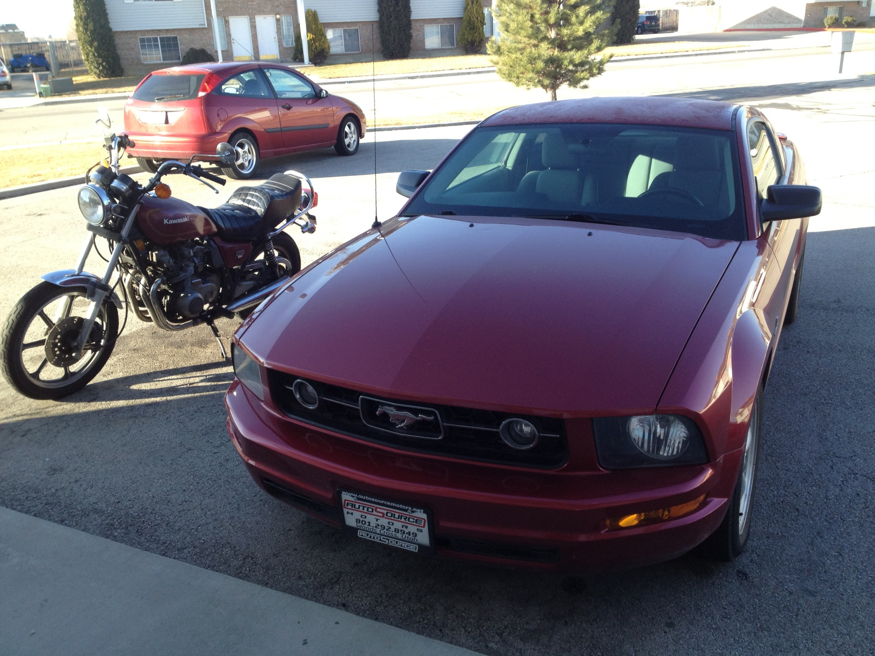
About Me…
Senior Software Engineer at Hexagon Metrology
Pattern crazy
  attribute, MVVM, factory, bridge, singleton, mediator, etc.
Software Architecture purist
  prefer strong architecture over getting it done fast
Not just a coder…(tester, hardware engineer, too)
  started as a hardware tester in C, then driving hardware in cross-platform C++, then .NET (Winforms), then Silverlight, ASP.NET (& jquery), and now WPF

Slide 3
What is this about?
Brief review of MVVM pattern from my talk 2 years ago
Overview of required strongly recommended code blocks for an MVVM application
Real-world needs, question, and answers about how to apply MVVM
Deep dive into an application of MVVM that leverages 3rd party tools and utilizes a robust core of custom MVVM classes

Slide 4
Assumptions
You all know WPF and/or Silverlight…already
  If not, learn that by itself first! Then come back to MVVM
Are already familiar with C# & .NET 4.5 (async/await, lambdas, TPL, thread safe collections, etc.)
You already are familiar with MVVM and have (hopefully) been involved in implementing it at least once

Slide 5
What is MVVM?
A Lightning Quick Review

Slide 6
Model
  Represents some data point that needs to persist in your application
  Can also be a ViewModel if it is a complex model
    E.g. Library contains many books by many different authors, etc. so Library would be retrieved by a data service, but it can then retrieve all of its books through the same or another data service. Bindings can be cascaded (e.g. Library.Books)
View
  XAML files
  Only cares about the UX
  Translates states and data from the ViewModel into a user experience using datatemplates, triggers, converters, etc.
  Binds to the ViewModel and/or the Model (usually both) and possibly one or more data services
ViewModel
  Acts as the glue for logical communication with the view and and models through data services, events, etc.

Slide 7
Recommended Code Blocks

Slide 8
Mediator/EventAggregator
Acts as a messaging service
  In Prism, this is the IEventAggregator implementation
  In MEFedMVVM/MvvmLite it is the Mediator
  Can be used in a generic fashion across the entire product through Controllers or used to just communicate between viewmodels…or whatever
  Shouldn’t matter how it’s used…just why
Its purpose is to decouple classes
Example:
  ViewModel A fires an event somewhere in the system
  Class B in a far away dll reacts to the event and starts cooking dinner
  ViewModel C in a still farther away dll reacts to the event and updates a prop
  Without a Mediator or something similar, Class B and ViewModel C would have to directly reference the instance of Class A and subscribe to Class A’s event – bad design (tight coupling and unnecessary code)!
This Demo uses the EventAggregator from Prism – show it!

Slide 9
View Injection Mechanism
Rationale: Ideally, views know very, very little about each other…maybe just by name only (interface moniker or something)
A View Injector…
  Can set content on ContentControl(s) or similar in a Shell (empty Window control) through Binding(s)
  Reacts to navigation requests from other sources and sets the content(s) on demand
This is accomplished by having a ShellView (a Window) with a ContentControl (and not much if anything else)
  The ViewInjector then latches onto the ContentControl (by attached properties or in the Shell’s ViewModel) and sets its content based on requests
  The content is an instance of another View
  Each contentcontrol represents a different region in the Shell
A Controller will then react to view injection requests and inject them into the right region
This demo uses the RegionManager from Prism – show it! (ShellView)

Slide 10
Data Services
Manages the Model or collection of Models
  Communicates with the back end to get and send data and present them as Model(s) to the consumer (ViewModel(s) or something else)
Architecture Bonus: Can obfuscate or decouple the actual objects in the back end from the Model(s) presented to the View by giving the ViewModel custom objects (allows for swapping out back ends easily)
Never needs the UI thread!
Has no idea how its data is presented or used
Can handle its own updates
Architecture Bonus: Can also implement INotifyPropertyChanged to fire events when its properties are updated
  Why can this be a good idea?
Show the TweetService

Slide 11
Logging System
  NLog, log4net, etc. (I prefer NLog)
  Keep the logger in a dll by itself for large projects; may combine with your infrastructure project for smaller ones
  This demo uses Nlog in the Infrastructure dll

Slide 12
Modularization Framework
  In order for concurrent development to be an attainable goal, the entire system must be modularized
  Modules should be allowed to be dropped in and ‘just work’ at any given time
  Modularization also dramatically aids in keeping things organized and decoupled over time
  …more on this later
  This demo uses Prism for modularization

Slide 13
IoC (Inversion of Control)
  Use whatever IoC system you want (Ninject, MEF, Unity, etc.)
  Unity – very common but manually tying of class to interface in a clunky way
  MEF – common as well, uses Attribute pattern to export/import classes
    Can also export/import many, and export/import functions
  Ninject – pretty cool way to do IoC; similar to Unity
  This demo uses MEF with a Prism bootstrapper

Slide 14
Bootstrapper
Sets up your application for IoC (mainly) and modularization
This demo uses a Prism/MEF bootstrapper
Show Bootstrapper and IoC with some MEF stuff

Slide 15
Common Services Implementation
OpenFileDialogService
FolderBrowserDialogService
MessageBoxService
DispatcherService
SaveFileService
I have implemented some form of all of these in my Infrastructure project. Feel free to use and reuse ☺

Slide 16
ViewModel Base class
Support Commands (some implementation of the ICommand interface)
  Use Prism’s DelegateCommand, MvvmLite’s RelayCommand, or others (I’m creating RelayCommands at runtime)
Supports firing PropertyChanged events
Uses collections that fire CollectionChanged events (if the collections will change during the lifetime of the VM)
Concerns with any VM base:
Static vs instance bindings in .NET 4.5??
PropertyChanged plumbing??
Unit testability??
Common services?? (MessageBox, Dispatcher, etc.)
** Deep Dive Into My Custom ViewModel **

Slide 17
Solution Architecture

Slide 18
Application project
  Has a shell view that stubs out regions for the other modules to inject views into
  Manages the lifetime of the app
  Contains the bootstrapper
  Contains module catalog
Infrastructure project (may be many of these)
  Houses commonly used and generic controls, models, classes, helpers, loggers, converters, and extensions used by the modules and app projects
Modules
  Each module houses a specific set of functionality
  Controller injects views as needed into regions and communicates logic changes to ViewModel’s, etc.
  Has an initializer that prepares the module for use one the system has been prepared for dependency injection, events, etc.
  Has Views, ViewModels, Models, Data Services, etc. that are all specific to the Module
  Modules never reference each other (why?)
  Modules communicate with each other (if they need to) through events

Slide 19
Demo old and re-architected projects

Slide 20
Real-World Concerns with MVVM
Nested UserControls
  When view is loaded, inject control(s) via Prism’s RegionManager
Tedious code writing for the PropertyChanged event
  See how any VM declares its bindable props
Loosely coupling the View and ViewModel together
  Many, many ways to this…I prefer MefedMVVM’s way (Blend friendly if you provide a version of the VM that is designer friendly – i.e. has an empty ctor)
Communicating state changes to the View from the ViewModel
  Made easy with the VisualStateManager and a GoToState handler (all in XAML) bound to propertychanged events on a prop in the VM
  See the UglyDisplayView /ViewModel
Knowing when things change in a model or ViewModel, or in any one of a collection of them
  The Rx framework is perfect for this very common scenario
  Provides an IDisposable observer for you to do this; just dispose when you’re done
  Example is in TweetsController.cs’s ctor

Slide 21
Questions?
Code => https://mvvmtwitterdemo.codeplex.com/releases/view/119694
Slides => http://utahcodecamp.com/downloads
Other MVVM Project (that’s actually a little useful): https://sourcecontrolmonitor.codeplex.com/
- Gives growl-like notifications for source control changes. Uses BeyondCompare automatically if installed for diffs.
- Supports SVN very well, and Git a bit, and maybe even TFS…can’t remember ☺

Slide 22
MVVM Resources/Frameworks
Prism – not an MVVM framework, but a fantastic aid in decoupling your layers and product components
  Provides an event aggregator, region manager (for view injection) and IoC
Caliburn
  Prefers convention over explicit code (a lot of the inner workings appear to be ‘magical’)
MEFedMVVM
  Provides a XAML based ViewModel injector, a Mediator, IVisualtStateManager and a bunch of other goodies
Cinch
  Provides a lot of very useful services and a decent ViewModel base right out of the box
  Relies on MEF and uses MEFedMVVM, as well
MVVM Light Toolkit
  Also provides an event aggregator for communication between modules and viewmodels
Go here for a detailed list…or make your own framework like I did for this demo!
Jeremy Likeness has an excellent series on how to use MEF instead of Prism
A guy on CodeProject who already did this tutorial…with much more detail (but with his own code)!
  But I dare say my MVVM implementation is better…oh yes, I dare say it.

